Slide 1
DOORDASH
By Olivia,Aanya,RIPLEY, and Janav

Slide 2
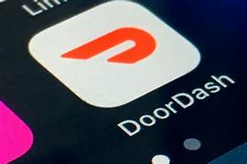

When was the startup founded?
Doordash was founded 1/12/2013.

Slide 3
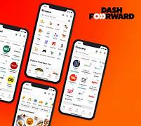

Who founded doordash
DoorDash was co-founded by Tony Xu, Stanley Tang, Andy Fang, and Evan Moore.
DoorDash was founded as PaloAltoDelivery.com in October 2012.

Slide 4

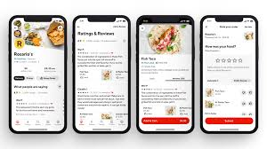
Why was it founded
It was founded to help small businesses the founders, while at Stanford, were inspired to create a service that would assist small businesses, particularly restaurants, that struggled with logistical challenges like managing their own delivery fleets.

Slide 5
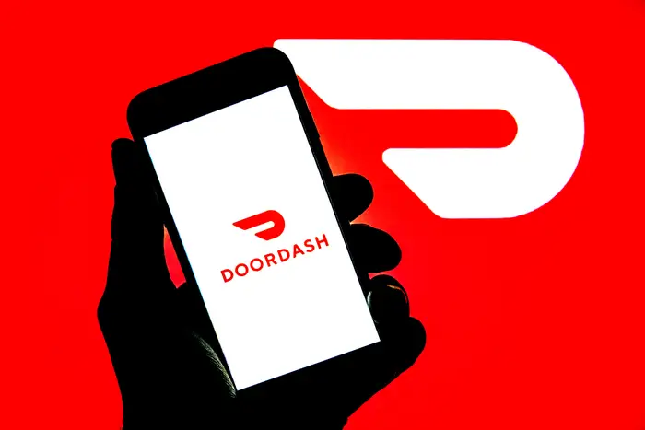
What Innovative Idea Did The Startup Propose
Doordash has several innovative ideas focusing on customer and merchant experiences. These include below
Using Generative AI
Managing multiple shopping carts
And Doordash Commerce Platform for merchants

Slide 6
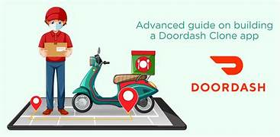
The history of doordash
Doordash’s origin story begins in 2012 with four stanford University students who aimed to help small businesses in italy.
They were working on a feedback app when a macaroon shop owner delivery needs sparked pivot.
This led to the creation of pal

Slide 7
Stock right now
The stock at july,31,2025 9:49 AM, is the 251$

Slide 8
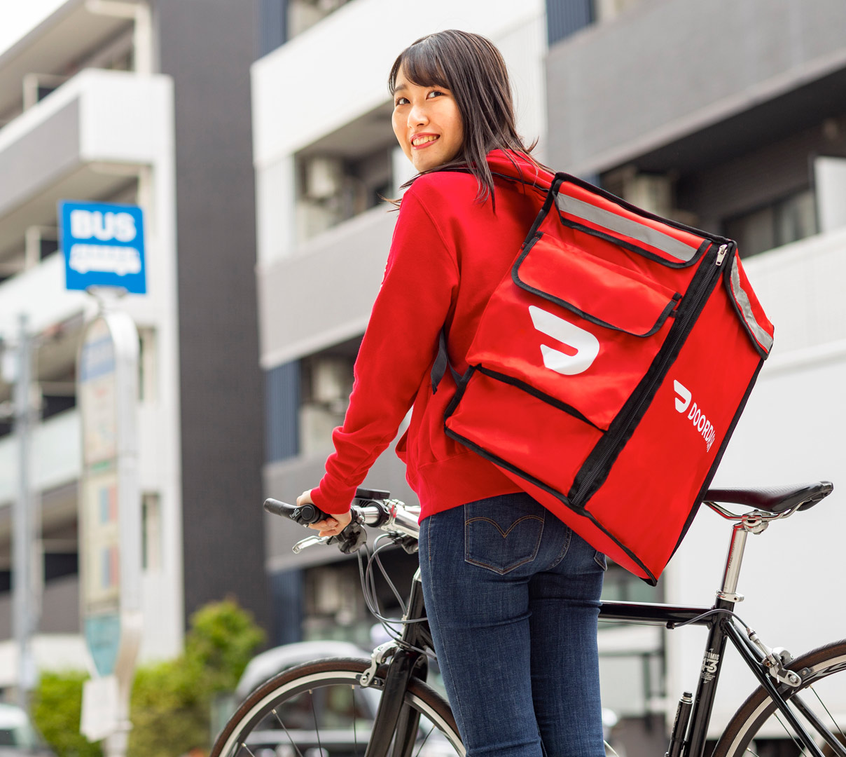
The history of doordash
Doordash began in 2013
4 people invented doordash
Doordash became popular in 2018

Slide 9
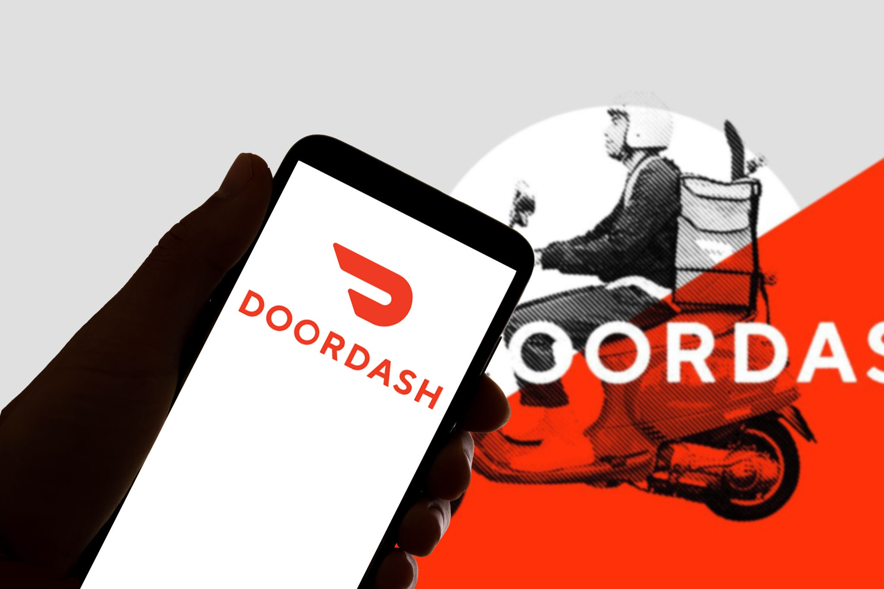
Is Doordash popular today?
Yes, Doordash had financial success and gained lots of popularity in 2018 and 2019
Doordash's success can be attributed to a combination of strategic choices.
Technological innovation, and focused execution that allowed them to differentiate themselves in a competitive market

Slide 10

Did DoorDash achieve its goal?
Could they have innovated further?
DoorDash's core goal is to empower and grow local economies by connecting consumers with local businesses
They did achieve their goal
They could have innovated numerous ways

Slide 11

Fun facts
Started with a different name: DoorDash initially launched in 2013 as PaloAltoDelivery.com by Stanford students Tony Xu, Stanley Tang, and Andy Fang. They would personally deliver orders from local restaurants.
In 2020 DoorDash saw a 241 revenue growth

Slide 12
Thank you
For listening

